Slide 1
Eigenvalues 1: Power Iteration and QR Factorization

Slide 2
What are eigenvalues and eigenvectors?
We have previously solved systems of equations of the form,
$$Ax=b.$$
This equation represents a system of linear equations for which we want to find the “solution” or the vector x that satisfies the equation.
Eigenvalues and eigenvectors are instead a solution of the equation of the form,
$$Av= λv$$
The boldface is important here!
A and v are vectors while λ is a scalar.
v is called the eigenvector while λ is called an eigenvalue.

Slide 3
What are eigenvalues and eigenvectors? Contd
This seems like a very technical or “mathematical” definition with no real intuitive interpretation.
That’s not true at all!
We have been looking at the multiplication of a matrix and a vector as a tool to represent systems of linear equations.
However, we can also view the multiplication of a matrix A as a linear transformation of a vector x into a new vector b.
$$Ax=b$$
We have taken the vector x and stretched or rotated it into the new vector b.

Slide 4
What are eigenvalues and eigenvectors? Contd
The eigenvalue equation
$$Av= λv$$
Is a very special case of this.
The action of the matrix A has NOT rotated the original vector v.
It has only stretched or shrunk the vector.
This direction and scaling are a property of the matrix itself.
These values have several applications which I will discuss in a bit.

Slide 5
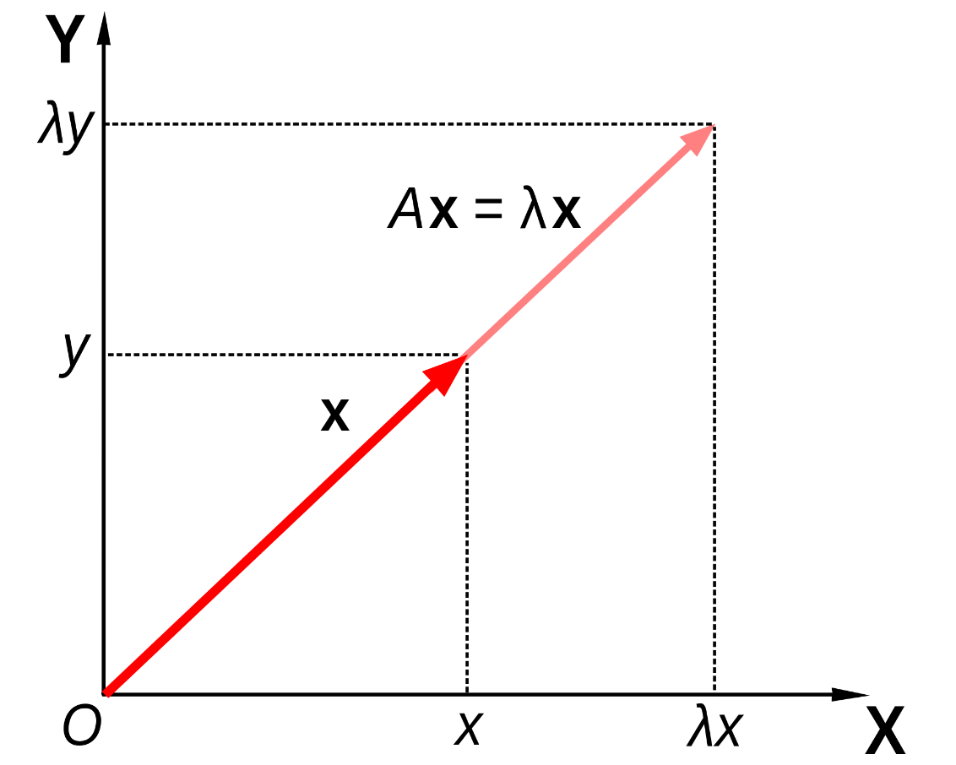
What are eigenvalues and eigenvectors visually?
https://en.wikipedia.org/wiki/Eigenvalues_and_eigenvectors

Slide 6
What are eigenvalues and eigenvectors visually? Contd
https://en.wikipedia.org/wiki/Eigenvalues_and_eigenvectors

Slide 7
How do we calculate eigenvalues and eigenvectors?
You’ve learned this in linear algebra but we’ll go over it again briefly.
We start with the formula,
$$Av= λv$$
And rewrite it as
$$Av−λv=0$$
$$\left(A−λI\right)v=0$$
This has a nonzero solution iff $\left|A−λI\right|=0.$
Thus, we have to find the values of $λ$ that satisfy this equation.
You’ve done this before numerous times by hand.

Slide 8
Characteristic Polynomial
Solving eigenvalues with the characteristic polynomial is often relatively simple to compute by hand for small matrices.
Again, we’ve all done this in a linear algebra class.
It boils down to finding the roots of a polynomial.
You may think of it as factoring a polynomial, but that’s the same thing.
As we’ve seen before, finding the roots of a polynomial can be quite tricky on a computer.
However, we will need a computer if we want to find the eigenvalues of an especially large matrix!

Slide 9
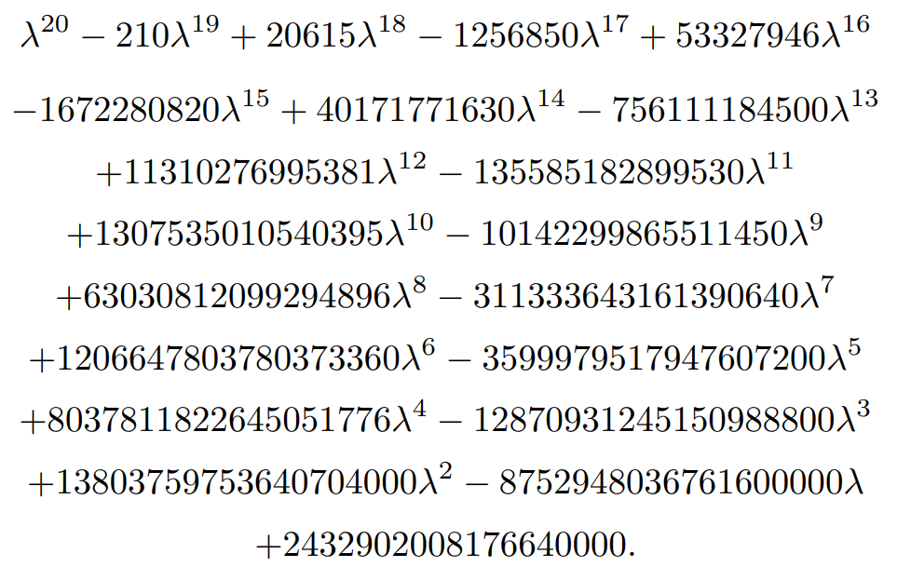
An example of an annoying Characteristic Polynomial
Consider the matrix with the numbers 1 through 20 on the main diagonal.
The eigenvalues are clearly the number 1 through 20.
However, consider the full characteristic polynomial when expanded out.
The coefficient range from 1 to 20!.
That’s not a typo, I mean the value 20!, 20
factorial.
We can’t even represent these coefficients
to full precision using IEEE doubles.
Sauer

Slide 10
An example of an annoying Characteristic Polynomial contd
If we used that polynomial to find the eigenvalues we wouldn’t be able to find them to machine precision because of the floating point issues.
We looked at this issue in more depth previously.
Looking at the polynomial is clearly not a suitable way for us to find the eigenvalues of a matrix.
We need another way.

Slide 11
Power Iteration
Since a direct method wasn’t suitable, we instead approach with an iterative method.
To motivate this first method, let’s look at an example:
$$A=\left[\begin{matrix}1 & 3 \\ 2 & 2\end{matrix}\right].$$
This matrix has two eigenvalues and eigenvectors
$λ_{1}=4,v_{1}=\left[\begin{matrix}1 \\ 1\end{matrix}\right]$ and $λ_{2}=−1,v_{2}=\left[\begin{matrix}−3 \\ 2\end{matrix}\right]$
Let’s multiply this matrix by some arbitrary vector $x=\left[\begin{matrix}−5 \\ 5\end{matrix}\right]$,
$$\left[\begin{matrix}1 & 3 \\ 2 & 2\end{matrix}\right]\left[\begin{matrix}−5 \\ 5\end{matrix}\right]=\left[\begin{matrix}10 \\ 0\end{matrix}\right]$$

Slide 12
Power Iteration Example
$$\left[\begin{matrix}1 & 3 \\ 2 & 2\end{matrix}\right]\left[\begin{matrix}−5 \\ 5\end{matrix}\right]=\left[\begin{matrix}10 \\ 0\end{matrix}\right]$$
Let’s do it again,
$$\left[\begin{matrix}1 & 3 \\ 2 & 2\end{matrix}\right]\left[\begin{matrix}10 \\ 0\end{matrix}\right]=\left[\begin{matrix}10 \\ 20\end{matrix}\right]$$
And let’s keep going,
$$\left[\begin{matrix}1 & 3 \\ 2 & 2\end{matrix}\right]\left[\begin{matrix}10 \\ 20\end{matrix}\right]=\left[\begin{matrix}70 \\ 60\end{matrix}\right]$$
$$\left[\begin{matrix}1 & 3 \\ 2 & 2\end{matrix}\right]\left[\begin{matrix}70 \\ 60\end{matrix}\right]=\left[\begin{matrix}250 \\ 260\end{matrix}\right]$$
At this point it’s useful to “normalize” the vector $\left[\begin{matrix}250 \\ 260\end{matrix}\right]=260\left[\begin{matrix}{25}/{26} \\ 1\end{matrix}\right]$
We have a vector that is very nearly in the same direction as the eigenvector $v_{1}=\left[\begin{matrix}1 \\ 1\end{matrix}\right]$.
Why is this?

Slide 13
Power Iteration Example contd
Note the sizes of the eigenvalues: 4 and -1.
Also, recall the effect of matrix multiplication on a vector, it serves to stretch or rotate a vector.
If the vector is near an eigenvector direction, the matrix multiplication will just scale the vector.
In our example, the eigenvector associated with the eigenvector 4 will dominate this multiplication.
At every step, it scales the vector by a factor of 4.
After 4 iterations it was on the order of $4^{4}$.
You could simply iterate this procedure to find the “dominant” eigenvalue and eigenvector, however it’s typically better to normalize the vector.

Slide 14
Power Iteration Algorithm
for i = 1:nstepmax
$v_{i−1}={x_{i−1}}/{{\left|\left|x_{i−1}\right|\right|}_{2}}$
$x_{i}=Av_{i−1}$
end
$$v_{i}={x_{i−1}}/{{\left|\left|x_{i−1}\right|\right|}_{2}}$$

Slide 15
Rayleigh Quotient
We will mostly take this for granted but I may return to it during our study of least squares methods.
The eigenvalue given an eigenvector can be approximated as,
$$λ=\frac{x^{T}Ax}{x^{T}x}$$
This is known as the Rayleigh Quotient, it is the best approximation of the eigenvalue with an approximate eigenvector.

Slide 16
Power Iteration Algorithm with Eigenvalue
for i = 1:nstepmax
$v_{i−1}={x_{i−1}}/{{\left|\left|x_{i−1}\right|\right|}_{2}}$
$x_{i}=Av_{i−1}$
$λ_{i}=v_{i−1}^{T}x_{i}$
end
$$v_{i}={x_{i−1}}/{{\left|\left|x_{i−1}\right|\right|}_{2}}$$

Slide 17
PageRank
Google actually uses a type of power iteration to calculation their PageRank sorting.
Google’s big break through in internet searching was to utilize the interconnectedness of the internet.
Instead of looking at how trafficked a page was, Google instead looked at how many websites linked back to a given website.
This is done by finding an adjacency matrix of all of the websites Google can see.
They then “guessed” an initial “popularity” and multiplied that adjacency matrix and the vector of “popularities”.
After iterating many many times, they get a good sense of which websites are most “important”

Slide 18
Inverse Power Iteration
We need a result from linear algebra I will preset without proof,
The eigenvalues of $A^{−1}$ are simply $λ_{i}^{−1}$ assuming the inverse exists.
We can use the power iteration method on this inverse matrix.
$$v_{i+1}=A^{−1}v_{i}$$
Doing so, we find the eigenvector associated with the largest magnitude eigenvalue $\left|λ_{i}^{−1}\right|$.
That is the same thing as the smallest magnitude eigenvalue $\left|λ_{i}\right|$.
We typically rewrite the power iteration here as
$$Av_{i+1}=v_{i}$$
Which we solve using Gaussian Elimination.

Slide 19
Inverse Power Iteration Algorithm
for i = 1:nstepmax
$v_{i−1}={x_{i−1}}/{{\left|\left|x_{i−1}\right|\right|}_{2}}$
$Solve\left(Ax_{i}=v_{i−1}\right)$
end
$$v_{i}={x_{i−1}}/{{\left|\left|x_{i−1}\right|\right|}_{2}}$$

Slide 20
So what about the other eigenvalues?
So far we have found 2 eigenvalues.
We’re going to be working with many dimensional systems with hundreds, thousands, or maybe more eigenvalues!
What about those?!
Well, we can modify the Inverse Power Iteration method slightly to help us in our search.
To do, we will need another property of eigenvalues,
The eigenvalues of the shifted matrix, $(A−sI)$ are $λ_{1}−s$, $λ_{2}−s,$ etc.
If we shift the matrix and use inverse power iteration on the matrix ${\left(A−sI\right)}^{−1}$, we find the eigenvector associated with the eigenvalue nearest to s.

Slide 21
Inverse Power Iteration (Shifted)
for i = 1:nstepmax
$v_{i−1}={x_{i−1}}/{{\left|\left|x_{i−1}\right|\right|}_{2}}$
$Solve\left(\left(A−sI\right)x_{i}=v_{i−1}\right)$
${\hat{λ}}_{i}=v_{i−1}^{T}x_{i}$
end
$$v_{i}={x_{i−1}}/{{\left|\left|x_{i−1}\right|\right|}_{2}}$$
The eigenvalue we want is thus ${λ=\hat{λ}}_{i}^{−1}+s$.

Slide 22
Rayleigh Quotient Iteration
We can speed up the Inverse Power iteration using the Rayleigh Quotient.
The convergence of IPI increases if we have a better guess of the eigenvalue that we can shift the matrix by.
So, we can estimate the eigenvalue at every step using the Rayleigh Quotient and shift the matrix by that amount.
This gives us extremely quick convergence!
IPI converges linearly while Rayleigh Quotient Iteration converges cubically!

Slide 23
Rayleigh Quotient Iteration Algorithm
for i = 1:nstepmax
$v_{i−1}={x_{i−1}}/{{\left|\left|x_{i−1}\right|\right|}_{2}}$
${\hat{λ}}_{i−1}=v_{i−1}^{T}Av_{i−1}$
$Solve\left(\left(A−{\hat{λ}}_{i−1}I\right)x_{i}=v_{i−1}\right)$
end
$$v_{i}={x_{i}}/{{\left|\left|x_{i}\right|\right|}_{2}}$$

Slide 24
Simultaneous Iteration
If we start with several initial guesses, we can power iterate on all of them at once to find multiple eigenvalues and eigenvectors.
If we begin with a set of pairwise orthogonal initial guess vectors and apply power iteration to all of them, we can try to approach all eigenvectors simultaneously.
To do this, we need to make sure our vectors always remain pairwise orthogonal.
To do that we will need QR decomposition.

Slide 25
Gram-Schmidt Orthogonalization
If we have a set of $m$ linearly independent vectors, $x_{i},$ in $R^{m}$, we can find a set of orthogonal vectors using Gram-Schmidt.
We find the first orthogonal vector by defining
$y_{1}=x_{1}$ and $q_{1}={y_{1}}/{{\left|\left|y_{1}\right|\right|}_{2}}$
To find the second vector we use
$y_{2}=x_{2}−q_{1}(q_{1}^{T}x_{2})$ and $q_{2}={y_{2}}/{{\left|\left|y_{2}\right|\right|}_{2}}$
At the i^{th} step we get
$y_{i}=x_{i}−q_{1}\left(q_{1}^{T}x_{i}\right)−q_{2}\left(q_{2}^{T}x_{i}\right)−…q_{i−1}\left(q_{i−1}^{T}x_{i}\right)$ and $q_{i}={y_{i}}/{{\left|\left|y_{i}\right|\right|}_{2}}$
If we define $r_{ii}={\left|\left|y_{i}\right|\right|}_{2}$ and $r_{ij}=q_{i}^{T}x_{j}$ we get can rewrite A=QR.

Slide 26
Gram-Schmidt Algorithm
for j = 1:n
$y = x_{j}$
for i = 1:j-1
$r_{ij}=q_{i}^{T}x_{j}$
$y = y−r_{ij}q_{i}$
end
$r_{jj}={\left|\left|y\right|\right|}_{2}$
$q_{j}=y/{r_{jj}}$
end

Slide 27
Unshifted QR Algorithm
We start by finding the QR decomposition of the matrix A.
We then iterate by finding $A_{i+1} = R_{i}Q_{i}$
Note that $A_{i+1} =Q_{i}^{−1}Q_{i}R_{i}Q_{i}=Q_{i}^{−1}A_{i}Q_{i}$ so the $A_{i}$’s are all similar and have the same eigenvalues.
Eventually this algorithm will put the matrix into an upper diagonal form and the eigenvalues can be read off the diagonal.
If the matrix is symmetric with no degenerate eigenvalues.

Slide 28
Unshifted QR Algorithm
$$A_{1}=Q_{1}R_{1}$$
for i = 1:nstepmax
$A_{i+1}=R_{i}Q_{i}$
$[Q_{i+1},R_{i+1}]=QR_Decomposition(A_{i+1})$
end

